Slide 1
Latent Dirichlet Allocation (LDA) aka Topic Modeling UGCA October 12, 2017
Anitesh Barua
aniteshb@gmail.com

Slide 2
1 Document, 1 Topic?
What are the topics in these documents?
“I like to eat broccoli and bananas.” → Food
“I ate a banana and spinach smoothie for breakfast.” → Food
“Chinchillas and kittens are cute.” → Cute pets
“My sister adopted a kitten yesterday.” → Cute pets
“Look at this cute hamster munching on a piece of broccoli.” → Cute pets & food
Latent Dirichlet Allocation (LDA): a way of automatically discovering topics that these docs contain
Topics are “latent” (hidden) – they have to be discovered

Slide 3
The Key Ideas
Topics and words
Topic A: 30% broccoli, 15% bananas, 10% breakfast, 10% munching, …
Topic B: 20% chinchillas, 20% kittens, 20% cute, 15% hamster, …
Documents and topics
Documents 1 and 2: 100% Topic A
Documents 3 and 4: 100% Topic B
Document 5: 60% Topic A, 40% Topic B

Slide 4
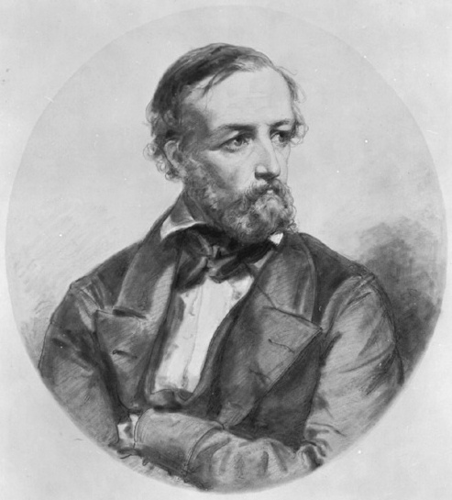
LDA Assumptions: A Bit of Theory (FYI only)
LDA represents documents as mixtures of topics
Topics contain words with certain probabilities
Documents were created as follows:
For each document, the author decided on
the number of words N (e.g., according to a Poisson distribution)
a topic mixture (according to a Dirichlet distribution over a set of K topics)
E.g., a document may have 1/3 food topic and 2/3 cute animals topic
The author generated each word in a document by:
Choosing a topic (according to the distribution above)
E.g., food topic with 1/3 probability & cute animals with 2/3 probability
Generate words (according to the topic’s distribution).
E.g., for the food topic, generate the word “broccoli” with 30% probability, “bananas” with 15% probability, etc.
Assuming this generative model for a collection of documents, LDA then tries to backtrack from the documents to find a set of topics that are likely to have generated the collection of docs.
Peter Gustav Dirichlet
1805-1859

Slide 5
Business Applications?

Slide 6
Clusters Vs. Topics
Clusters are identified by words appearing frequently in documents
Topic(s) implied by these words are the user’s interpretation
A document can belong to only one cluster
Topic modeling: A document can have multiple topics (which are “latent”)
Attempts to recover the topics contained in each document

Slide 7
Topics for Final Project
You are a consultant to a brand, organization, politician, etc.
Analysis of competing brands or products
E.g., airlines, automobiles, hotels, smartphones, etc.
Track events (e.g., political) or marketing campaigns
Whether social mentions reflect the intended messages
Predict outcomes from social chatter
E.g., box office revenues, stock prices, etc.
Develop a crowdsourced recommendation system
Provide actionable insights from social mentions using unstructured data analytics
Copyright Anitesh Barua 2017

Slide 8
Final Project Competition: Key Steps
Collect mentions
Analyze important words, merge
Calculate lifts
WebScraper or custom script,
Twitter API,
Youtube scraper, etc.
Brand maps
(Multidimensional scaling)
Business Insights:
Examples (for products)
Real competitors (brands)?
What people talk about
Which attributes matter the most
Which are positive (negative)?
Branding & marketing implications
Sentiment Analysis
Cosine Similarity
Topic modeling (If applicable)
Network Analysis (if applicable)
Copyright Anitesh Barua 2017

Slide 9
Get Ready for Final Project
Create your own group (assignment 3 & 4 are group activities)
6 students per group
No more than 8 groups
Come up with 3 ideas per group
Meet during the week of Oct 23-27

